Slide 1


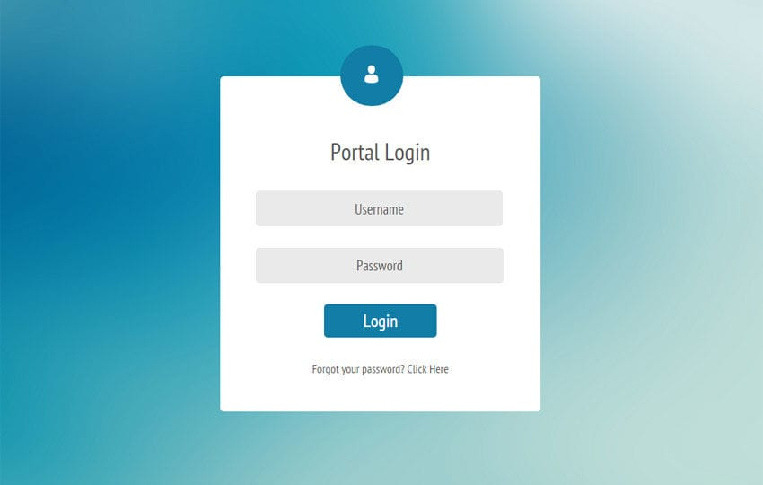

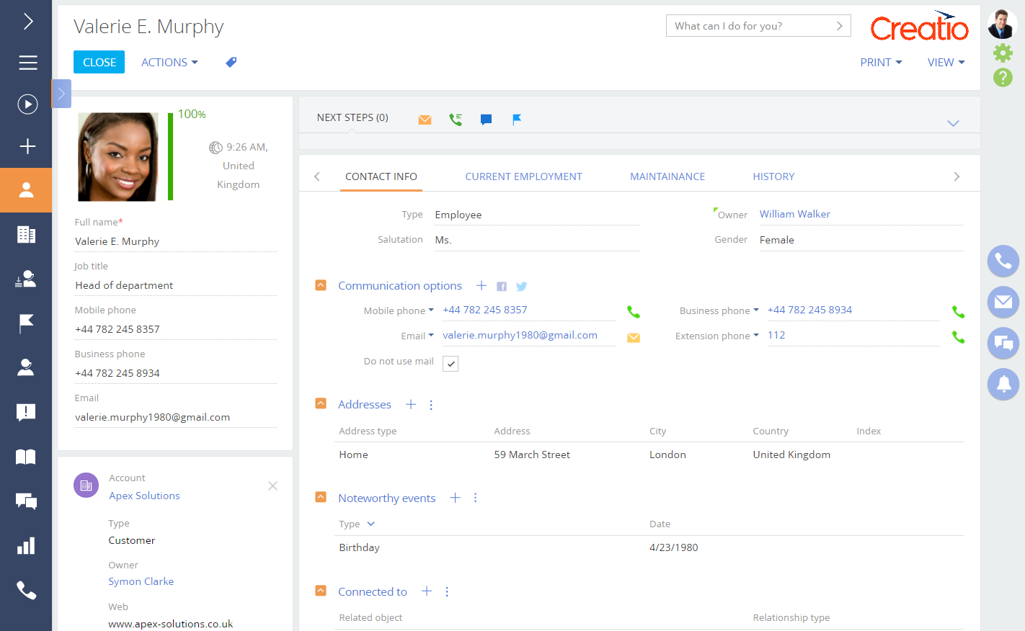
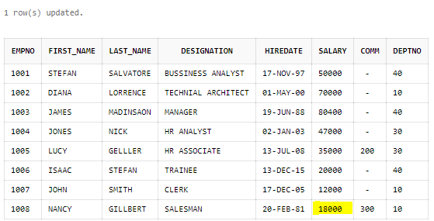
Manufacturing Unit Monitoring System
You manufacture, we will keep track….
Features
About-Us
Login

Slide 2

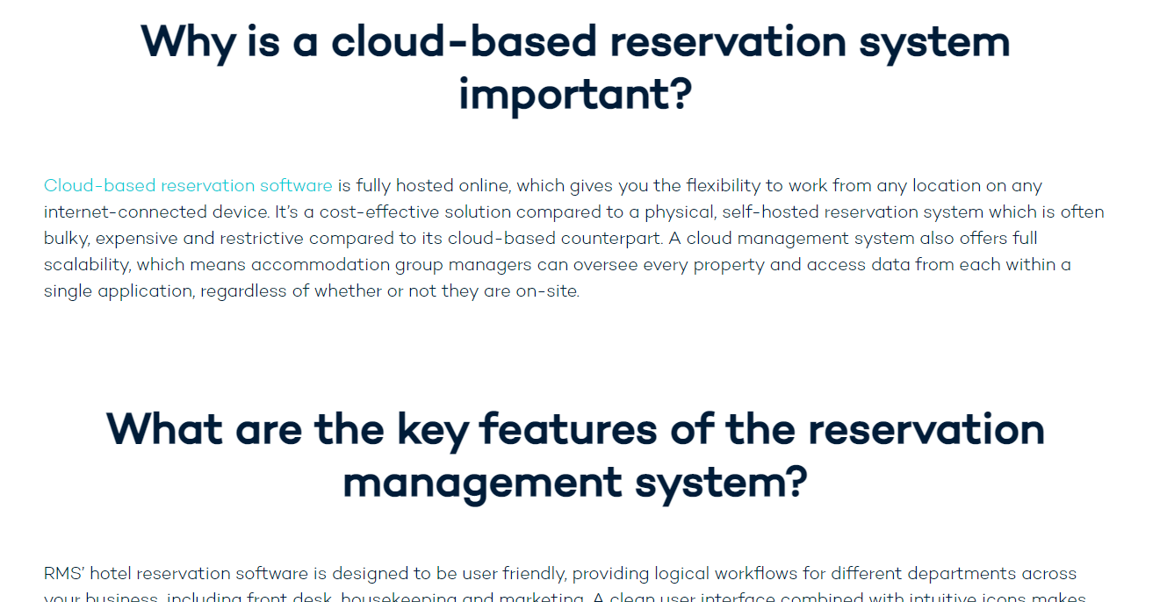

Slide 3
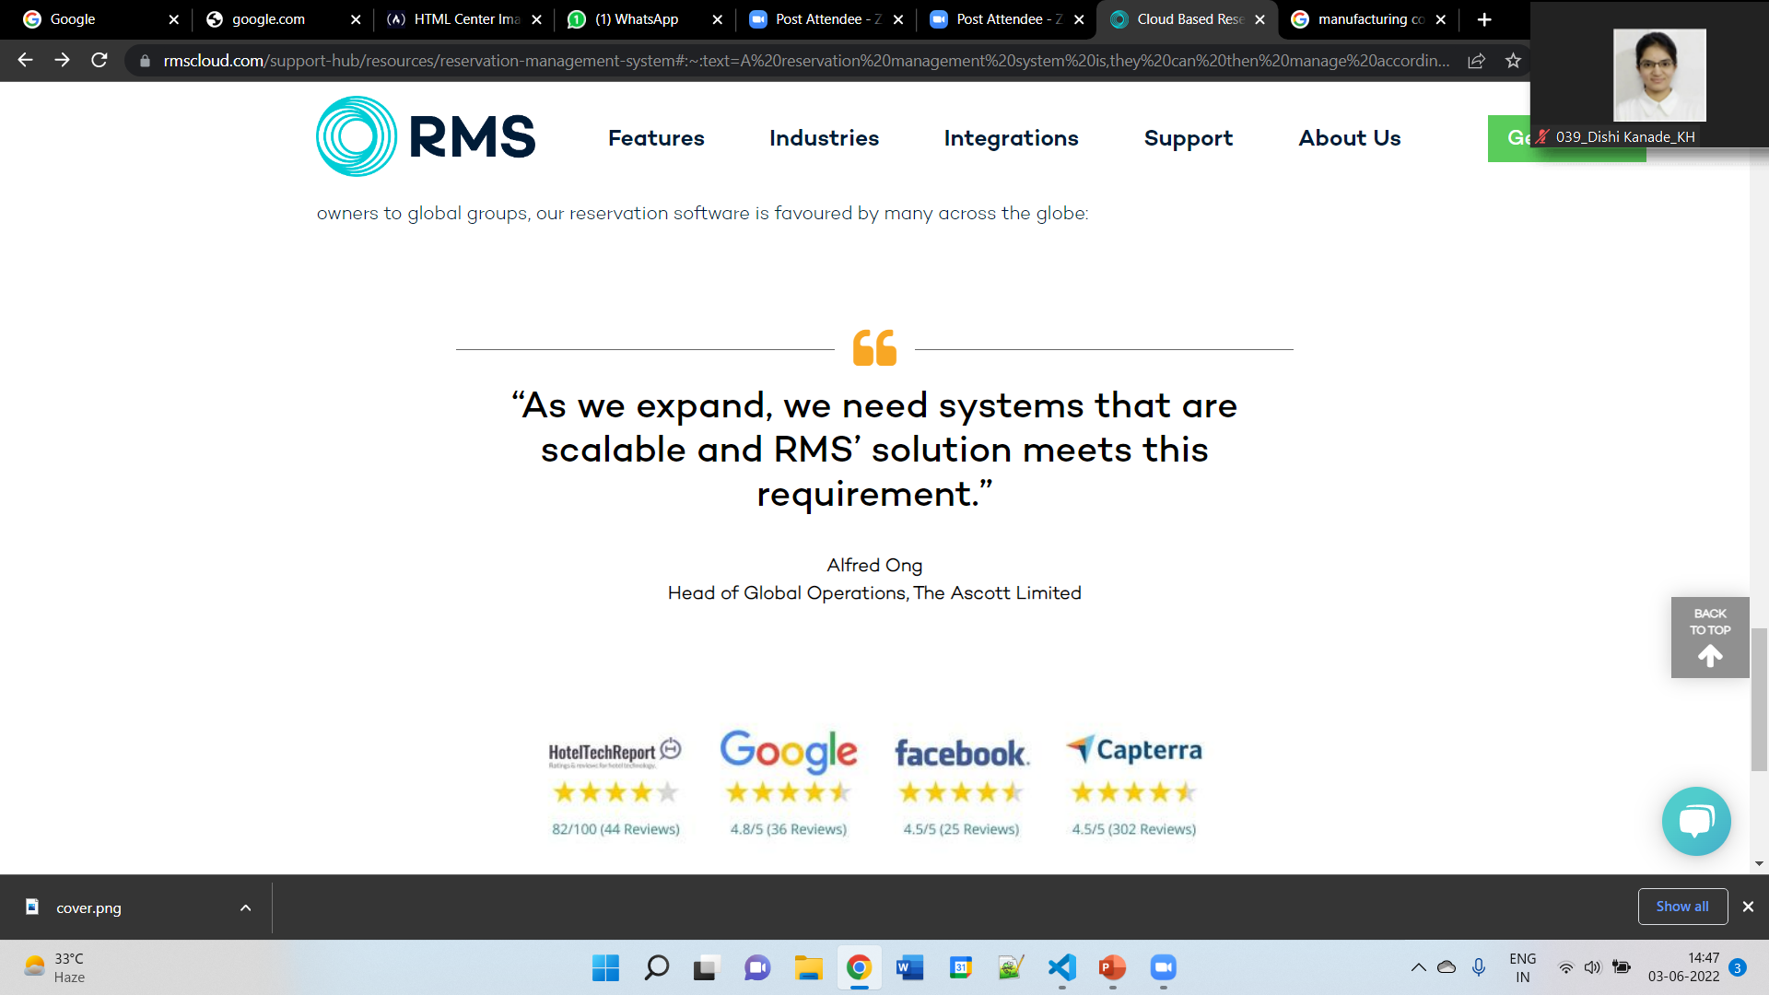

Slide 4
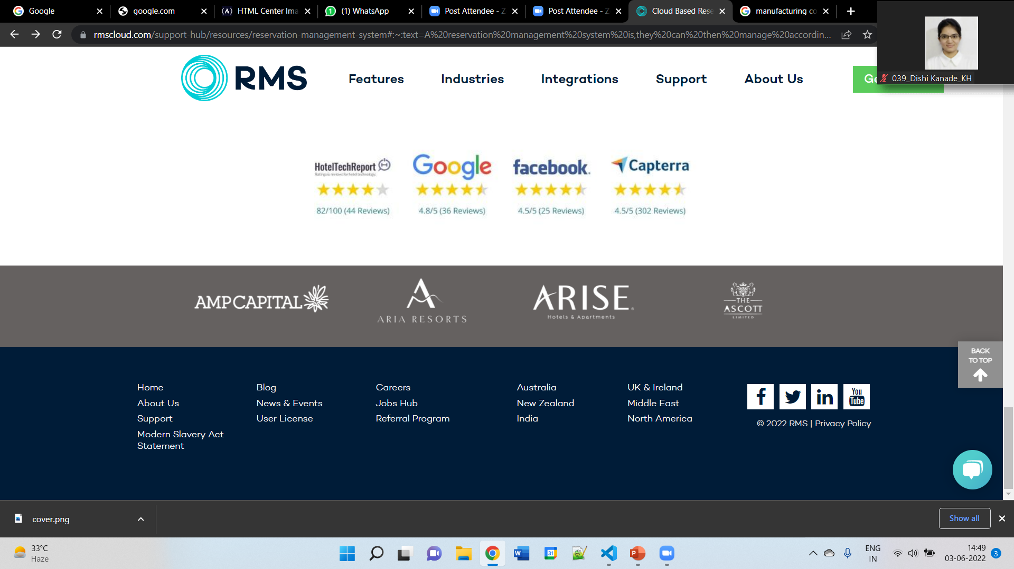

Slide 5
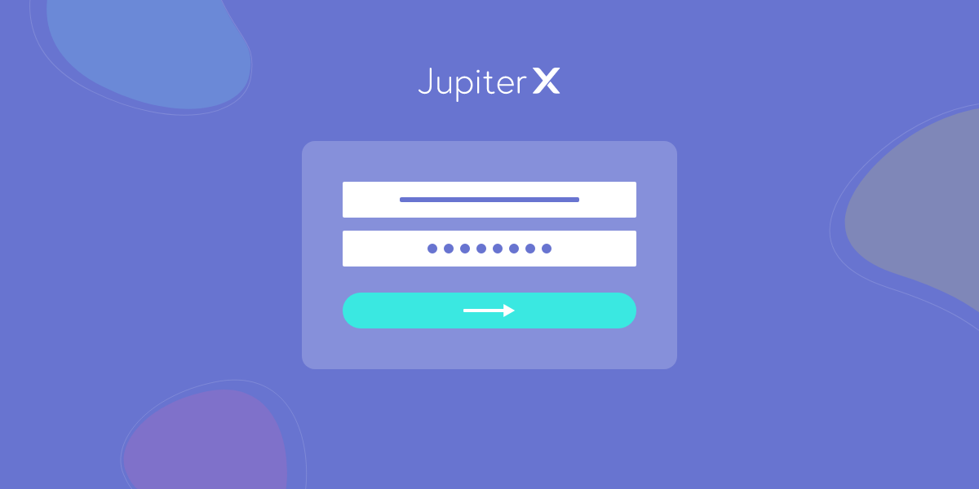
Customer
Employee
Admin

Slide 6


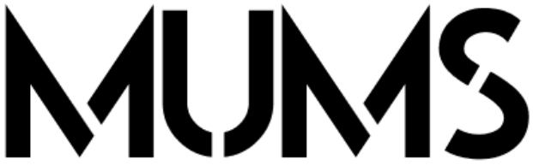
MUMS

Slide 7
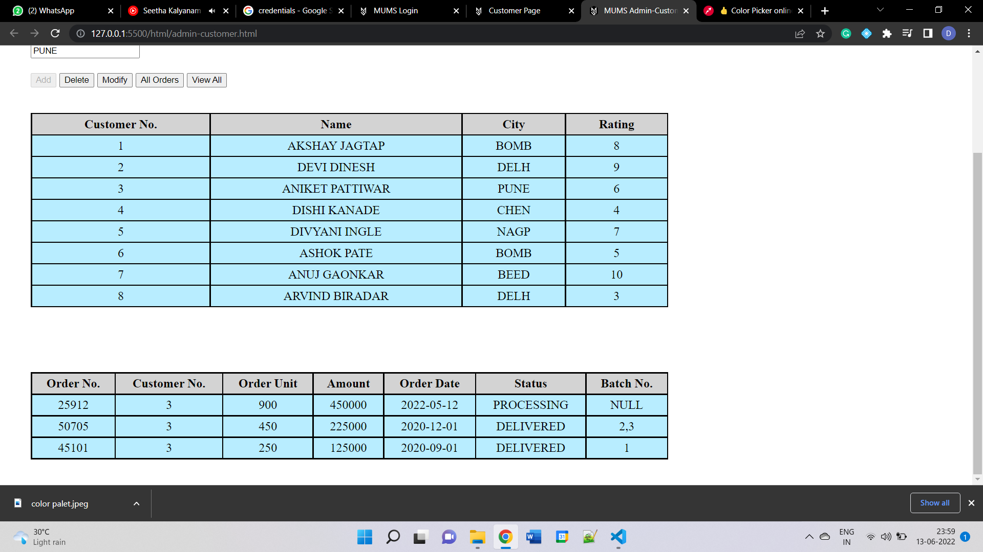
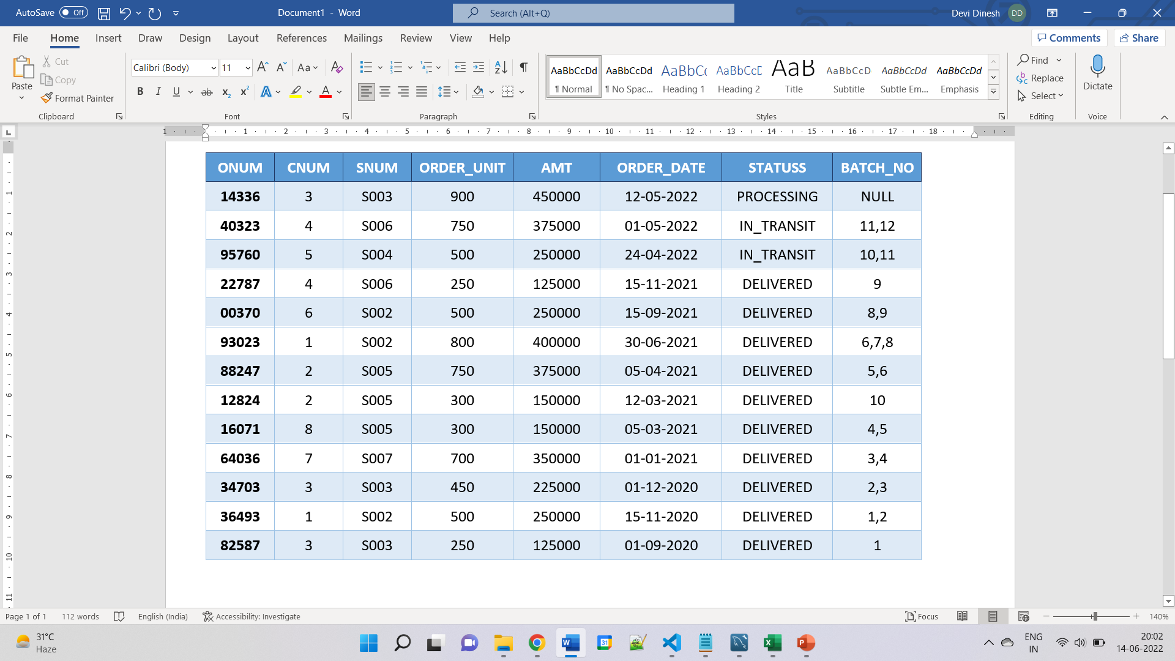
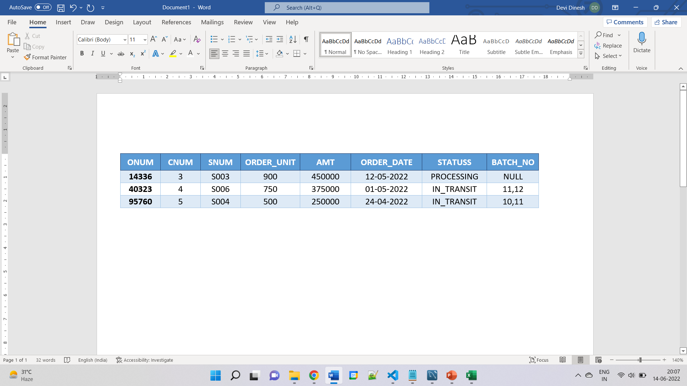

Slide 8
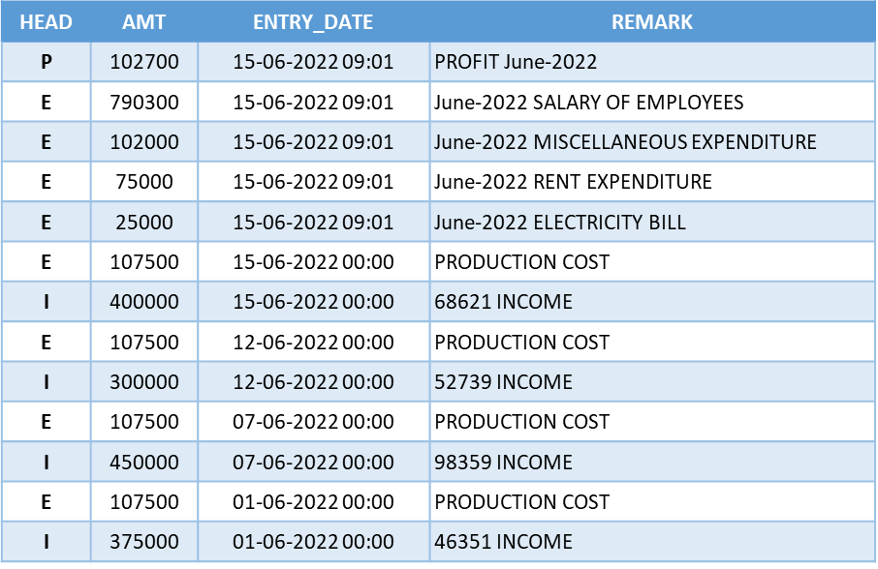
HEAD | AMT | ENTRY_DATE | REMARK
P | 102700 | 15-06-2022 09:01 | PROFIT June-2022
E | 790300 | 15-06-2022 09:01 | June-2022 SALARY OF EMPLOYEES
E | 102000 | 15-06-2022 09:01 | June-2022 MISCELLANEOUS EXPENDITURE
E | 75000 | 15-06-2022 09:01 | June-2022 RENT EXPENDITURE
E | 25000 | 15-06-2022 09:01 | June-2022 ELECTRICITY BILL
E | 107500 | 15-06-2022 00:00 | PRODUCTION COST
I | 400000 | 15-06-2022 00:00 | 68621 INCOME
E | 107500 | 12-06-2022 00:00 | PRODUCTION COST
I | 300000 | 12-06-2022 00:00 | 52739 INCOME
E | 107500 | 07-06-2022 00:00 | PRODUCTION COST
I | 450000 | 07-06-2022 00:00 | 98359 INCOME
E | 107500 | 01-06-2022 00:00 | PRODUCTION COST
I | 375000 | 01-06-2022 00:00 | 46351 INCOME

Slide 9
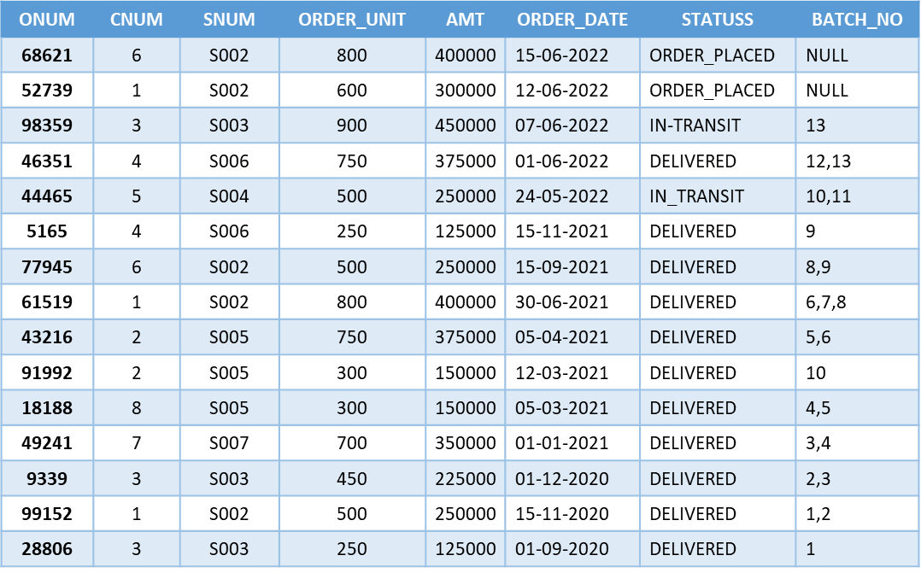
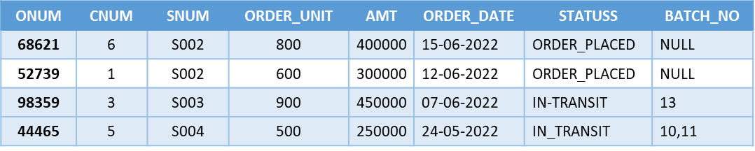
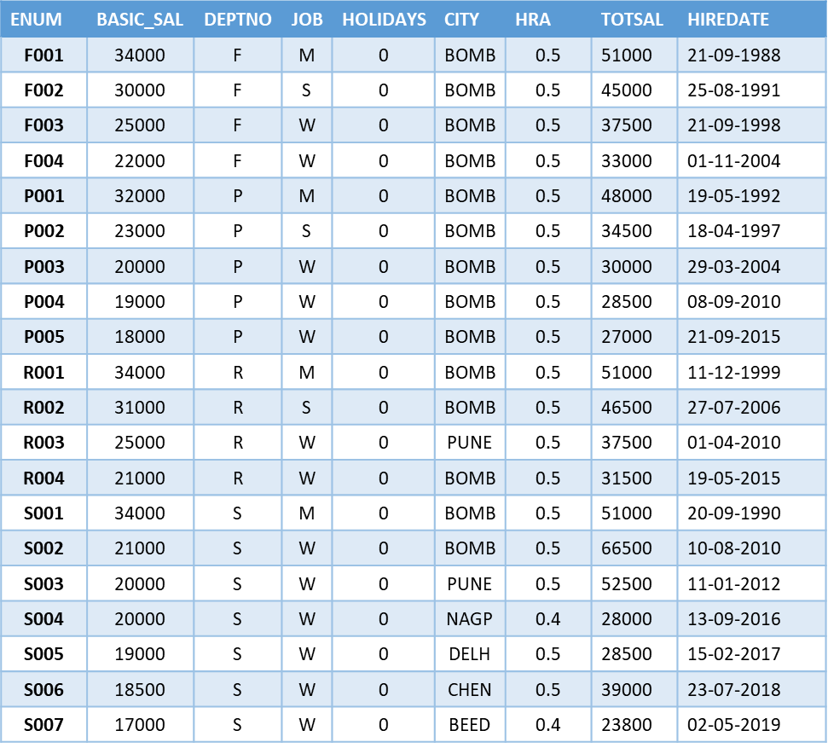
 | CNUM | SNUM | ORDER_UNIT | AMT | ORDER_DATE | STATUSS | BATCH_NO
 | 6 | S002 | 800 | 400000 | 15-06-2022 | ORDER_PLACED | NULL
 | 1 | S002 | 600 | 300000 | 12-06-2022 | ORDER_PLACED | NULL
 | 3 | S003 | 900 | 450000 | 07-06-2022 | IN-TRANSIT | 13
 | 5 | S004 | 500 | 250000 | 24-05-2022 | IN_TRANSIT | 10,11

Slide 10
SR_NO | ENUM | USER | TIME_STAMP | REMARK
95 | P003 | AKSHAY@localhost | 15-06-2022 09:00 | ORDER NO: 46351 STATUS UPDATED TO DELIVERED
94 | P002 | AKSHAY@localhost | 15-06-2022 08:59 | ORDER NO: 98359 STATUS UPDATED TO IN-TRANSIT
93 | P003 | AKSHAY@localhost | 15-06-2022 08:56 | ORDER NO: 46351 NOT FOUND FOR UPDATE
92 | P002 | AKSHAY@localhost | 15-06-2022 08:55 | ORDER NO: 98359 NOT FOUND FOR UPDATE
91 | P002 | AKSHAY@localhost | 15-06-2022 08:54 | ORDER NO: 82222 NOT FOUND FOR UPDATE
90 | S003 | DEVIP@localhost | 15-06-2022 08:52 | S003 MONTHLY SAL+COMMISSION UPDATED IN TOTAL SALARY
89 | S002 | DEVIP@localhost | 15-06-2022 08:52 | S002 MONTHLY SAL+COMMISSION UPDATED IN TOTAL SALARY
88 | S006 | DEVIP@localhost | 15-06-2022 08:52 | S006 MONTHLY SAL+COMMISSION UPDATED IN TOTAL SALARY
87 | S001 | DEVIP@localhost | 15-06-2022 08:52 | S001 MONTHLY SAL UPDATED IN TOTAL SALARY
86 | R004 | DEVIP@localhost | 15-06-2022 08:52 | R004 MONTHLY SAL UPDATED IN TOTAL SALARY
85 | R003 | DEVIP@localhost | 15-06-2022 08:52 | R003 MONTHLY SAL UPDATED IN TOTAL SALARY
84 | R002 | DEVIP@localhost | 15-06-2022 08:52 | R002 MONTHLY SAL UPDATED IN TOTAL SALARY
83 | R001 | DEVIP@localhost | 15-06-2022 08:52 | R001 MONTHLY SAL UPDATED IN TOTAL SALARY
82 | P005 | DEVIP@localhost | 15-06-2022 08:52 | P005 MONTHLY SAL UPDATED IN TOTAL SALARY
81 | P004 | DEVIP@localhost | 15-06-2022 08:52 | P004 MONTHLY SAL UPDATED IN TOTAL SALARY
80 | P003 | DEVIP@localhost | 15-06-2022 08:52 | P003 MONTHLY SAL UPDATED IN TOTAL SALARY
79 | P002 | DEVIP@localhost | 15-06-2022 08:52 | P002 MONTHLY SAL UPDATED IN TOTAL SALARY
78 | P001 | DEVIP@localhost | 15-06-2022 08:52 | P001 MONTHLY SAL UPDATED IN TOTAL SALARY
77 | F004 | DEVIP@localhost | 15-06-2022 08:52 | F004 MONTHLY SAL UPDATED IN TOTAL SALARY
76 | F003 | DEVIP@localhost | 15-06-2022 08:52 | F003 MONTHLY SAL UPDATED IN TOTAL SALARY
75 | F002 | DEVIP@localhost | 15-06-2022 08:52 | F002 MONTHLY SAL UPDATED IN TOTAL SALARY
74 | F001 | DEVIP@localhost | 15-06-2022 08:52 | F001 MONTHLY SAL UPDATED IN TOTAL SALARY
73 | 0 | AKSHAY@localhost | 15-06-2022 08:52 | PRODUCTION REQUEST PLACED SUCESSFULLY
72 | S002 | AKSHAY@localhost | 15-06-2022 08:52 | ORDER NO: 68621 PLACED FOR CUST NO: 6 BY EMP NO: S002
71 | 0 | AKSHAY@localhost | 15-06-2022 08:52 | PRODUCTION REQUEST PLACED SUCESSFULLY
70 | S002 | AKSHAY@localhost | 15-06-2022 08:52 | ORDER NO: 52739 PLACED FOR CUST NO: 1 BY EMP NO: S002
69 | 0 | AKSHAY@localhost | 15-06-2022 08:52 | PRODUCTION REQUEST PLACED SUCESSFULLY
68 | 0 | AKSHAY@localhost | 15-06-2022 08:52 | PRODUCTION REQUEST PLACED SUCESSFULLY
67 | 0 | AKSHAY@localhost | 15-06-2022 08:52 | PRODUCTION REQUEST PLACED SUCESSFULLY
66 | 0 | AKSHAY@localhost | 15-06-2022 08:52 | PRODUCTION REQUEST PLACED SUCESSFULLY
65 | 0 | AKSHAY@localhost | 15-06-2022 08:52 | PRODUCTION REQUEST PLACED SUCESSFULLY
64 | 0 | AKSHAY@localhost | 15-06-2022 08:52 | PRODUCTION REQUEST PLACED SUCESSFULLY
63 | 0 | AKSHAY@localhost | 15-06-2022 08:52 | PRODUCTION REQUEST PLACED SUCESSFULLY
62 | 0 | AKSHAY@localhost | 15-06-2022 08:52 | PRODUCTION REQUEST PLACED SUCESSFULLY
61 | 0 | AKSHAY@localhost | 15-06-2022 08:52 | PRODUCTION REQUEST PLACED SUCESSFULLY
60 | 0 | AKSHAY@localhost | 15-06-2022 08:52 | PRODUCTION REQUEST PLACED SUCESSFULLY
59 | 0 | AKSHAY@localhost | 15-06-2022 08:52 | PRODUCTION REQUEST PLACED SUCESSFULLY
58 | 0 | AKSHAY@localhost | 15-06-2022 08:52 | PRODUCTION REQUEST PLACED SUCESSFULLY
57 | 0 | AKSHAY@localhost | 15-06-2022 08:52 | PRODUCTION REQUEST PLACED SUCESSFULLY
56 | S005 | ANIKET@localhost | 15-06-2022 08:52 | SALESMAN ALLOCATED TO CUSTOMER 8 SUCESSFULLY
55 | S007 | ANIKET@localhost | 15-06-2022 08:52 | SALESMAN ALLOCATED TO CUSTOMER 7 SUCESSFULLY
54 | S002 | ANIKET@localhost | 15-06-2022 08:52 | SALESMAN ALLOCATED TO CUSTOMER 6 SUCESSFULLY
53 | S004 | ANIKET@localhost | 15-06-2022 08:52 | SALESMAN ALLOCATED TO CUSTOMER 5 SUCESSFULLY
52 | S006 | ANIKET@localhost | 15-06-2022 08:52 | SALESMAN ALLOCATED TO CUSTOMER 4 SUCESSFULLY
51 | S003 | ANIKET@localhost | 15-06-2022 08:52 | SALESMAN ALLOCATED TO CUSTOMER 3 SUCESSFULLY
50 | S005 | ANIKET@localhost | 15-06-2022 08:52 | SALESMAN ALLOCATED TO CUSTOMER 2 SUCESSFULLY
49 | S002 | ANIKET@localhost | 15-06-2022 08:52 | SALESMAN ALLOCATED TO CUSTOMER 1 SUCESSFULLY
48 | 0 | ANIKET@localhost | 15-06-2022 08:52 | ARVIND BIRADAR CUSTOMER ADDED SUCESSFULLY
47 | 0 | ANIKET@localhost | 15-06-2022 08:52 | ANUJ GAONKAR CUSTOMER ADDED SUCESSFULLY
46 | 0 | ANIKET@localhost | 15-06-2022 08:52 | ASHOK PATE CUSTOMER ADDED SUCESSFULLY
45 | 0 | ANIKET@localhost | 15-06-2022 08:52 | DIVYANI INGLE CUSTOMER ADDED SUCESSFULLY
44 | 0 | ANIKET@localhost | 15-06-2022 08:52 | DISHI KANADE CUSTOMER ADDED SUCESSFULLY
43 | 0 | ANIKET@localhost | 15-06-2022 08:52 | ANIKET PATTIWAR CUSTOMER ADDED SUCESSFULLY
42 | 0 | ANIKET@localhost | 15-06-2022 08:52 | DEVI DINESH CUSTOMER ADDED SUCESSFULLY
41 | 0 | ANIKET@localhost | 15-06-2022 08:52 | AKSHAY JAGTAP CUSTOMER ADDED SUCESSFULLY
40 | S007 | DEVIP@localhost | 15-06-2022 08:51 | S007 HRA=0.4 AND DETAILS ADDED SUCESSFULLY
39 | S006 | DEVIP@localhost | 15-06-2022 08:51 | S006 HRA=0.5 AND DETAILS ADDED SUCESSFULLY
38 | S005 | DEVIP@localhost | 15-06-2022 08:51 | S005 HRA=0.5 AND DETAILS ADDED SUCESSFULLY
37 | S004 | DEVIP@localhost | 15-06-2022 08:51 | S004 HRA=0.4 AND DETAILS ADDED SUCESSFULLY
36 | S003 | DEVIP@localhost | 15-06-2022 08:51 | S003 HRA=0.5 AND DETAILS ADDED SUCESSFULLY
35 | S002 | DEVIP@localhost | 15-06-2022 08:51 | S002 HRA=0.5 AND DETAILS ADDED SUCESSFULLY
34 | S001 | DEVIP@localhost | 15-06-2022 08:51 | S001 HRA=0.5 AND DETAILS ADDED SUCESSFULLY
33 | P005 | DEVIP@localhost | 15-06-2022 08:51 | P005 HRA=0.5 AND DETAILS ADDED SUCESSFULLY
32 | P004 | DEVIP@localhost | 15-06-2022 08:51 | P004 HRA=0.5 AND DETAILS ADDED SUCESSFULLY
31 | P003 | DEVIP@localhost | 15-06-2022 08:51 | P003 HRA=0.5 AND DETAILS ADDED SUCESSFULLY
30 | P002 | DEVIP@localhost | 15-06-2022 08:51 | P002 HRA=0.5 AND DETAILS ADDED SUCESSFULLY
29 | P001 | DEVIP@localhost | 15-06-2022 08:51 | P001 HRA=0.5 AND DETAILS ADDED SUCESSFULLY
28 | R004 | DEVIP@localhost | 15-06-2022 08:51 | R004 HRA=0.5 AND DETAILS ADDED SUCESSFULLY
27 | R003 | DEVIP@localhost | 15-06-2022 08:51 | R003 HRA=0.5 AND DETAILS ADDED SUCESSFULLY
26 | R002 | DEVIP@localhost | 15-06-2022 08:51 | R002 HRA=0.5 AND DETAILS ADDED SUCESSFULLY
25 | R001 | DEVIP@localhost | 15-06-2022 08:51 | R001 HRA=0.5 AND DETAILS ADDED SUCESSFULLY
24 | F004 | DEVIP@localhost | 15-06-2022 08:51 | F004 HRA=0.5 AND DETAILS ADDED SUCESSFULLY
23 | F003 | DEVIP@localhost | 15-06-2022 08:51 | F003 HRA=0.5 AND DETAILS ADDED SUCESSFULLY
22 | F002 | DEVIP@localhost | 15-06-2022 08:51 | F002 HRA=0.5 AND DETAILS ADDED SUCESSFULLY
21 | F001 | DEVIP@localhost | 15-06-2022 08:51 | F001 HRA=0.5 AND DETAILS ADDED SUCESSFULLY
20 | S007 | DEVIP@localhost | 15-06-2022 08:51 | S007 EMPLOYEE ADDED SUCESSFULLY
19 | S006 | DEVIP@localhost | 15-06-2022 08:51 | S006 EMPLOYEE ADDED SUCESSFULLY
18 | S005 | DEVIP@localhost | 15-06-2022 08:51 | S005 EMPLOYEE ADDED SUCESSFULLY
17 | S004 | DEVIP@localhost | 15-06-2022 08:51 | S004 EMPLOYEE ADDED SUCESSFULLY
16 | S003 | DEVIP@localhost | 15-06-2022 08:51 | S003 EMPLOYEE ADDED SUCESSFULLY
15 | S002 | DEVIP@localhost | 15-06-2022 08:51 | S002 EMPLOYEE ADDED SUCESSFULLY
14 | S001 | DEVIP@localhost | 15-06-2022 08:51 | S001 EMPLOYEE ADDED SUCESSFULLY
13 | P005 | DEVIP@localhost | 15-06-2022 08:51 | P005 EMPLOYEE ADDED SUCESSFULLY
12 | P004 | DEVIP@localhost | 15-06-2022 08:51 | P004 EMPLOYEE ADDED SUCESSFULLY
11 | P003 | DEVIP@localhost | 15-06-2022 08:51 | P003 EMPLOYEE ADDED SUCESSFULLY
10 | P002 | DEVIP@localhost | 15-06-2022 08:51 | P002 EMPLOYEE ADDED SUCESSFULLY
9 | P001 | DEVIP@localhost | 15-06-2022 08:51 | P001 EMPLOYEE ADDED SUCESSFULLY
8 | R004 | DEVIP@localhost | 15-06-2022 08:51 | R004 EMPLOYEE ADDED SUCESSFULLY
7 | R003 | DEVIP@localhost | 15-06-2022 08:51 | R003 EMPLOYEE ADDED SUCESSFULLY
6 | R002 | DEVIP@localhost | 15-06-2022 08:51 | R002 EMPLOYEE ADDED SUCESSFULLY
5 | R001 | DEVIP@localhost | 15-06-2022 08:51 | R001 EMPLOYEE ADDED SUCESSFULLY
4 | F004 | DEVIP@localhost | 15-06-2022 08:51 | F004 EMPLOYEE ADDED SUCESSFULLY
3 | F003 | DEVIP@localhost | 15-06-2022 08:51 | F003 EMPLOYEE ADDED SUCESSFULLY
2 | F002 | DEVIP@localhost | 15-06-2022 08:51 | F002 EMPLOYEE ADDED SUCESSFULLY
1 | F001 | DEVIP@localhost | 15-06-2022 08:51 | F001 EMPLOYEE ADDED SUCESSFULLY

Slide 11
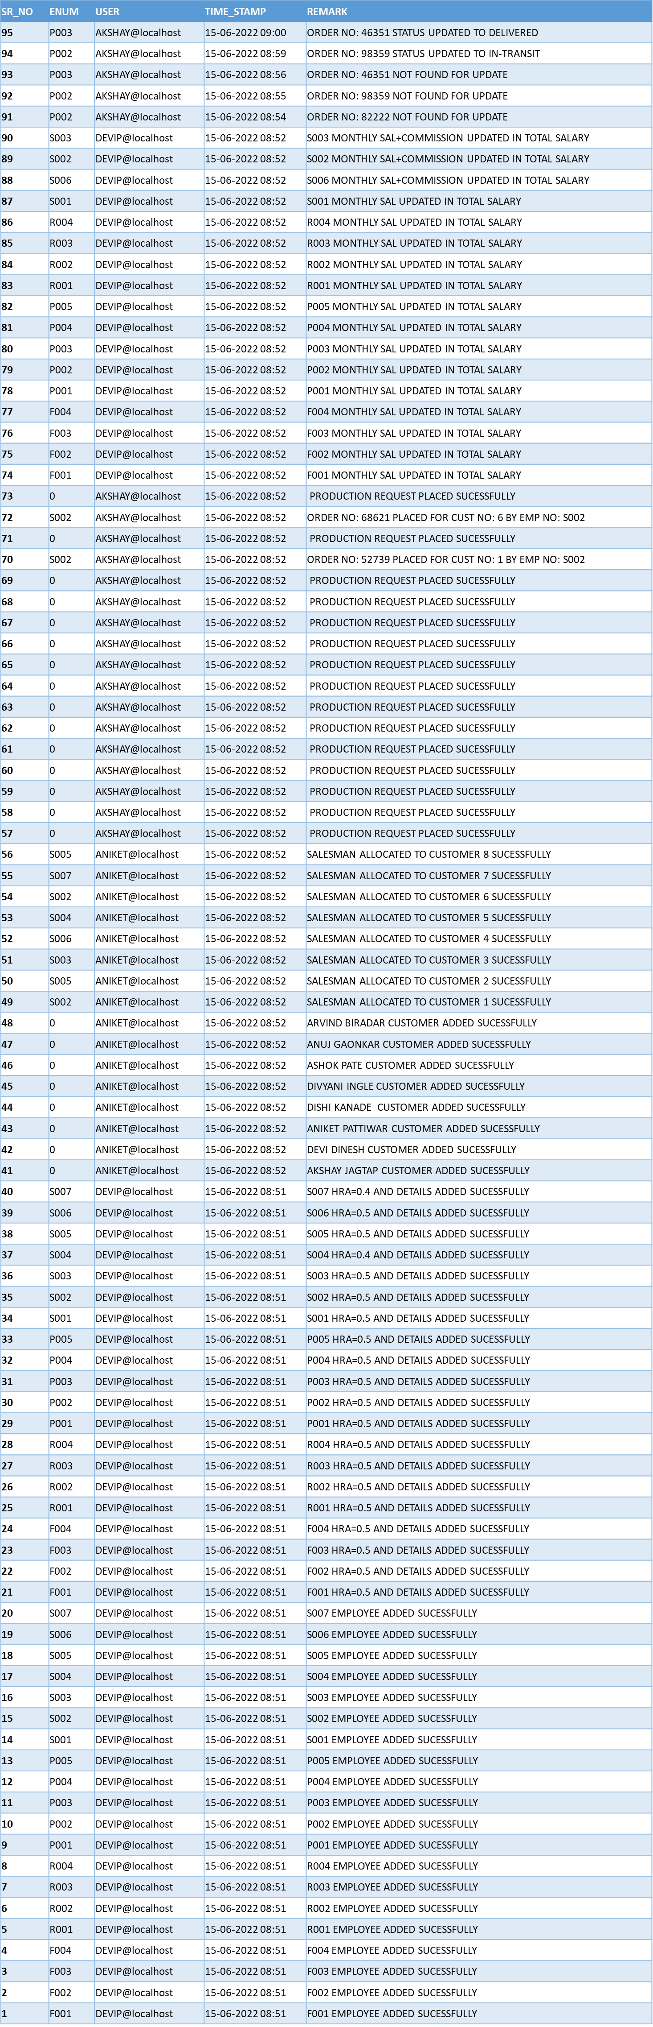

Slide 12

MUMS

Slide 13


